Slide 1
Leadership in Business and Society
BUSN 3052
Leadership behaviour and motivation
Lecture 2
Material largely drawn from: Lussier, RN & Achua, CF 2016 Leadership: theory, application and skill development, 6th edition, Cengage Learning, Boston.

Slide 2
Learning Objectives
Understand leadership behaviours
Describe the University of Iowa leadership styles
Describe the University of Michigan and Ohio State University leadership models
Describe Leadership Grid
Identify entrepreneurial leadership behaviour
Discuss the importance of motivation for leaders
Describe motivation theories;
  Content
  Process
  Reinforcement

Slide 3
Leadership Behaviour
Leaders’ behaviour is based on their traits and skills.
Leading by example is important.
  Behaviour is easier to learn and change than traits.

Slide 4
Leadership Style
Leadership style is the combination of traits, skills, and behaviours leaders use as they interact with followers.
  While based on traits and skills, the important component of a leadership style is behaviour.
    Consistent patterns of behavior characterise a leader.
No ‘one’ best style.

Slide 5
University of Iowa Leadership Styles
Autocratic leadership style
  The autocrat makes the decisions, tells employees what to do and closely supervises workers.
Democratic leadership style
  The democrat encourages participation in decisions, allows the group to determine tasks and does not closely supervise employees.

Slide 6
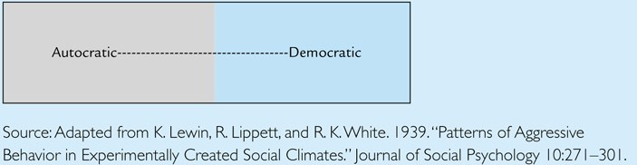
University of Iowa Leadership Styles …
A leader’s style usually falls somewhere between autocrat and democrat.

Slide 7
University of Michigan Leadership Model
Two leadership styles
Job (task)-centered leadership style
  has scales measuring goal emphasis and work facilitation.
Employee (people)-centered leadership style
  has scales measuring supportive leadership and interaction facilitation.

Slide 8
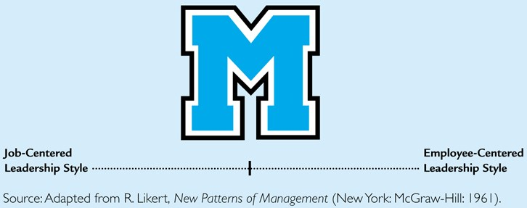
University of Michigan Leadership Model
    Refers to the extent to which the leader takes charge to get the job done.
    Refers to the extent to which the leader focuses on meeting employee needs and developing relationships.

Slide 9
Ohio State University
Developed the Leader Behaviour Description Questionnaire (LBDQ).
  Initiating structure behavior:
    Same as job-centered – focuses on task completion.
  Consideration behavior:
    Same as employee-centered – focuses on meeting people’s needs and developing relationships.
Identifies four leadership styles

Slide 10
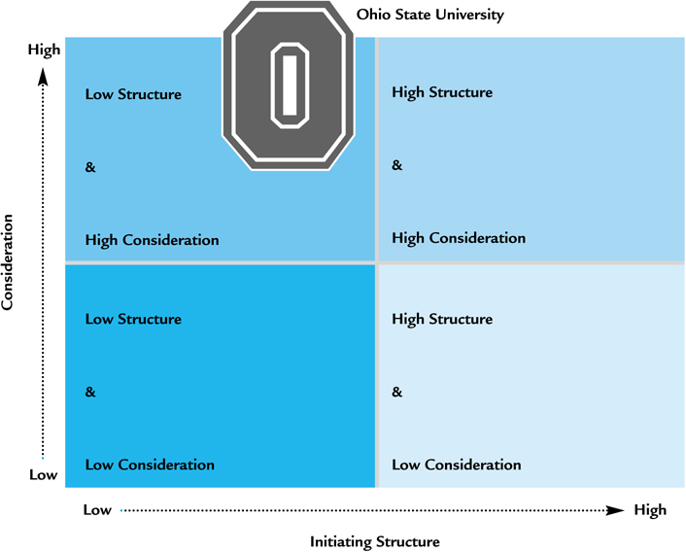
Ohio State University

Slide 11
Discuss
Do you agree with the University of Michigan model (with two leadership styles) or with the Ohio State model (with four leadership styles)?

Slide 12
The Leadership Grid
The Leadership Grid builds on the Ohio State and Michigan studies.
  Based on the same two leadership dimensions, here called:
    Concern for production, and
    Concern for people.
  Measured on a scale from 1 to 9, giving 81 possible combinations of concern.
The Leadership Grid identifies five leadership styles:
  1,1 impoverished
  9,1 authority compliance
  1,9 country club
  5,5 middle of the road
  9,9 team leader

Slide 13
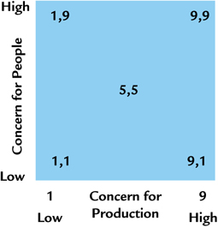
The Leadership Grid …
The impoverished leader (1,1) does the minimum required to remain employed.
The authority compliance leader (9,1) focuses on getting the job done but treats people like machines.
The country-club leader (1,9) maintains a friendly atmosphere without regard to production.
The middle-of-the-road leader (5,5) strives to maintain satisfactory performance and morale.
The team leader (9,9) strives for maximum performance and employee satisfaction.

Slide 14
Discuss
Do you agree with the Leadership Grid’s claim that the one best leadership style is the team leader (9,9)?

Slide 15
High-High Leader Research
The high-high leader has concern for both production and people
  Team leadership style
There is some support for the high-high leader style as the universal theory.
  Results in improved performance, low absenteeism and turnover, and high employee satisfaction
However, it is not accepted as the one best style in all situations.
  Weak correlation among the leadership behaviour with subordinate performance

Slide 16
Behavioural Theory Contributions
Behavioural research led to the shift in paradigm to contingency leadership theory.
Recognises that organisations need both production and people leadership.
Supports coleadership.
  One leader is production-oriented.
  One leader is people-oriented.

Slide 17
Entrepreneurial Behaviour
An important concern in today’s fast changing world.
Entrepreneurship refers to initiating a business venture, organising resources and assuming the associated risks and rewards.
Important characteristics are:
  Vision and dissatisfaction with the present
  Ability to get people on board
  Flexibility, openness to feedback and ability to learn and adapt
  Persistence and execution
A source of innovation and change for established organisations.

Slide 18
Discuss
What are the similarities and differences between the University of Michigan and Ohio State University leadership models?
What are the similarities and differences between the Ohio State University Leadership Model and the Leadership Grid?

Slide 19
Leadership and Motivation
Motivation is anything that affects behaviour in pursuing a certain outcome.
Employee motivation affects productivity.
Part of a leader’s job is to channel followers’ motivation to achieve organisation’s vision and goals.

Slide 20
Motivation Theories
Content Motivation Theories
Hierarchy of needs theory
Process Motivation Theories
Equity theory
Reinforcement Theory
Two-factor theory
Acquired needs theory
Expectancy theory
Goal-setting theory
Positive
Avoidance
Extinction
Punishment

Slide 21
Content Motivation Theories
Content motivation theories focus on explaining and predicting behavior based on people’s needs. Includes:
  Hierarchy of Needs Theory
  Two-Factor Theory
  Acquired Needs Theory
The key to successful leadership is to meet the needs of employees while achieving organisational objectives.

Slide 22
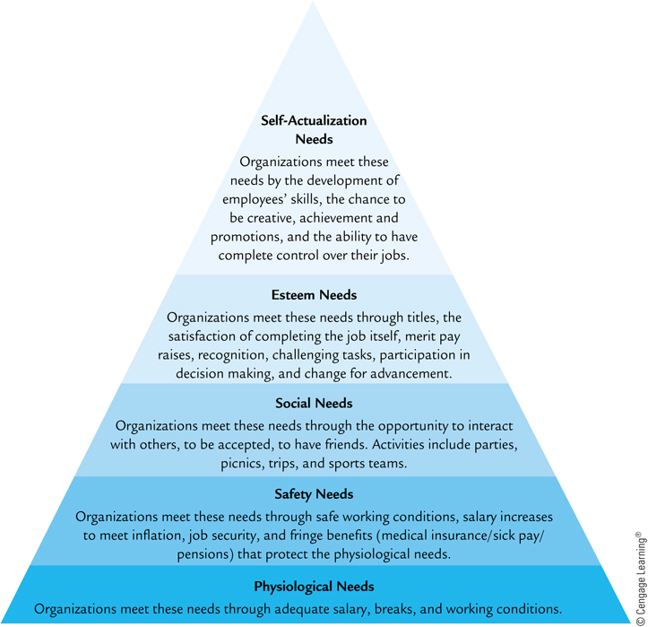
Maslow’s Hierarchy of Needs Theory

Slide 23
Two-Factor Theory
In the 1960’s Frederick Herzberg combined lower-level needs he called hygiene or maintenance (extrinsic motivators).
  Job security, working conditions, salary
Higher-level needs he called motivators (intrinsic motivators).
  Recognition, growth, advancement, more responsbilities
The two-factor theory proposes that people are motivated by motivators rather than maintenance factors.

Slide 24
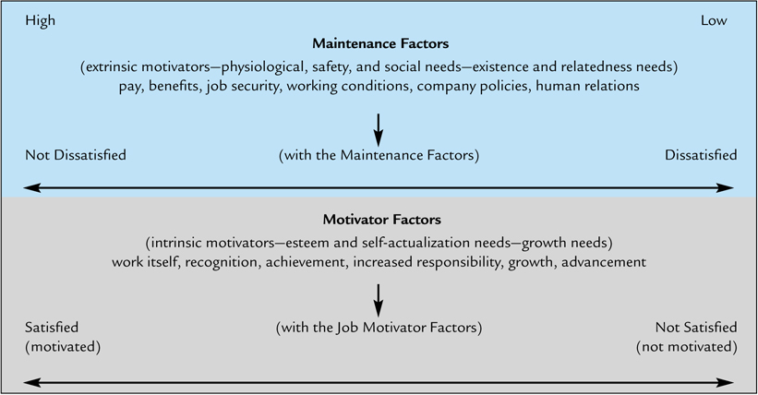
Two-Factor Theory …

Slide 25
Acquired Needs Theory
People are motivated by their need for achievement, power, and affiliation.
  Motivating employees with a high n Ach:
    Give them challenging tasks with clear objectives.
  Motivating employees with a high n Pow:
    Let them plan/control their jobs as much as possible.
  Motivating employees with a high n Aff:
    Let them work as part of a team.

Slide 26
Needs of People and Motivation Methods
Conventional management approaches:
  Individual’s lower, basic needs
  Extrinsic rewards and punishments
  Control the behaviour of employees by manipulating their decisions about how to act
  People perform adequately
Leadership approaches:
  Satisfy higher need
  Intrinsic rewards
  Employee engagement (empower)
  People achieve their best possible performance

Slide 27
Process Motivation Theories
Focus on understanding how people choose behaviour to fulfill their needs.
  Equity theory
  Expectancy theory
  Goal-setting theory

Slide 28
Equity Theory
Equity theory proposes that people are motivated when their perceived inputs equal outputs.
People compare their inputs and outputs to that of relevant others and conclude if they are under-rewarded, over-rewarded, or equitably rewarded.
When inequity is perceived, employees attempt to correct the balance.

Slide 29
Motivating With Equity Theory
When employees believe they are equitably rewarded, they are not actively motivated.
When employees feel under-rewarded, they are demotivated.
Equity theory offers useful information:
  Equity is based on perception,
  Reward equitably, and
  Reward high performance.

Slide 30
Expectancy Theory
Expectancy theory proposes that people are motivated when they believe they can accomplish the task, they will get the reward, and the rewards for doing the task are worth the effort.
Based on Victor Vroom’s formula:
motivation = expectancy x instrumentality x valence

Slide 31
Expectancy Theory …
  Expectancy
    the person’s perception of his/her ability (probability) to accomplish an objective – self-efficacy.
  Instrumentality
    belief that the performance will result in getting the reward.
  Valence
    the value a person places on the outcome or reward.

Slide 32
Motivating With Expectancy Theory
These conditions result in motivation:
  Clearly defined objectives and the performance needed to achieve them.
  Tie performance to rewards.
  Be sure rewards are of value to employees.
  Make sure employees believe you will do what you say.

Slide 33
Goal-Setting Theory
Goal-setting theory proposes that specific, difficult goals motivate people.
Goal setting might be the most effective management tool available.

Slide 34
Reinforcement Theory
Reinforcement theory proposes that through the consequences for behaviour, people will be motivated to behave in predetermined ways.
Two important concepts used to modify behaviour are the types of reinforcement and the schedules of reinforcement.

Slide 35
Types of Reinforcement
Positive reinforcement:
  Offer attractive consequences.
Avoidance reinforcement:
  Also called negative reinforcement,
  Employee avoids negative consequence.
Extinction:
  Withhold reinforcement when behaviour occurs.
Punishment:
  Undesirable consequence.

Slide 36
Schedules of Reinforcement
Continuous reinforcement:
  Every desired behaviour is reinforced.
Intermittent reinforcement:
  When based on time – interval schedule
  When based on output – ratio schedule

Slide 37
Motivating with Reinforcement
You get what you reinforce.
General guidelines for using reinforcement:
  Set clear objectives,
  Select appropriate reinforcement,
  Select appropriate reinforcement schedule,
  Do not reward mediocre or poor work,
  Look for positives and give praise,
  Give sincere praise every day, and
  Do things for your employees.

Slide 38
Discuss
What are the similarities and differences among the three content motivation theories?
What are the major similarities and differences among the three process motivation theories?

Slide 39
Case Study
Facebook COO Sheryl Sandberg
How would Sheryl Sandberg’s leadership style be described based on the four behavioural leadership styles?
How does Sandberg’s book Lean In emphasise the three content motivation theories?
How does Sandberg’s book Lean In emphasise the three process motivation theories?
Which type and schedule of reinforcement will help women to advance in business?
How do the five dimensions of our leadership definition apply to Sandberg as COO of Facebook?
What managerial leadership skills does Sandberg need as COO of Facebook?
How would you describe Sandberg’s Big Five Personality, and do you believe she has the personality profile of an effective leader?

Slide 40
Summary
Leaders’ behaviour is based on their traits and skills.
Leadership behavioural theories:
  University of Iowa studies
  University of Michigan studies
  Ohio studies
  Leadership grid
Motivation affects behavior
Content motivation theories explains and predicts behaviour based on people’s needs.
  Hierarchy of Needs Theory
  Two-Factor Theory
  Acquired Needs Theory
Process motivation theories helps to understand how people choose behaviour to fulfill their needs.
  Equity theory
  Expectancy theory
  Goal-setting theory

